Slide 1

Internship Overview
Tuesday, July 30th
— Danielle Wanke

Slide 2
Overview:
What is the Change Governance Office?
Daily Life of a Tech Writing Intern
Working with Archer
Process Maps
Personal Reflection
Questions

Slide 3
What is the Change Governance Office?

Slide 4
What is the Change Governance Office?
The Change Governance Office is part of the Risk and Compliance organization. It is responsible for all tasks related to writing, publishing, and governing Policies, Standards, and Procedures.
What we do:
Provide governance of enterprise-wide P&P process and ensure the documents are standardized using the official Company P&P Style Guides
Setup approval flow for P&Ps
Coordinate all requests for P&P external releases
Provide periodic reporting on status of P&P maintenance and approval
Store all P&Ps in Nationstar’s eGRC system (Archer)

Slide 5
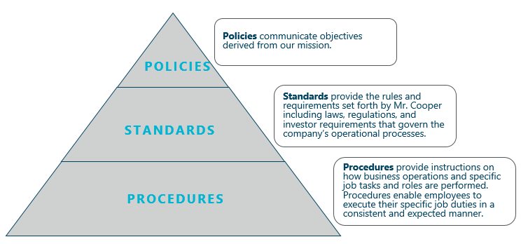
Why do P&Ps matter?
The 1st thing you are probably asking…
What are Policies, Standards, and Procedures??
Policies, Standards, and Procedures are the 3 document types, collectively known as “P&Ps”.
The 2nd thing you are probably asking…
What is the point of having P&Ps?
Prove compliance to 3rd parties such as regulators, investors, and potential new business clients
FLOD, QC and Internal Audit testing
New hire training and support normal training processes
Ensure customers receive the best possible experience with Mr. Cooper
Ensure critical control activities are completed
Required during some litigations
Support business continuity planning
Provide historical snapshots of Mr. Cooper’s past

Slide 7
Daily life of a Technical Writing Intern

Slide 8
My Day-to-Day
P&P Support
Create/update process maps
Create tier 1 maps
Assist with Process Map & Policy Framework Implementation
Obtain approval from Process Map owners
Quality Control
Technical Writers
Create/update P&Ps for change of law/investor, business process change and annual reviews and gather approvals via Archer (Servicing & Corporate)
Support high priority P&Ps in response to Exam Management and RFP Due Diligence
Handle all projects related to P&Ps
Interact with SMEs (Subject Matter Experts) to update documents
Create and process PCRs (Policy Change Requests) through our SharePoint site/Archer Examples: Policy Framework Implementation

Slide 9
Working in Archer

Slide 10
Working in Archer
Training in Archer was about 3 weeks long and encompassed so many different aspects of document management. A few of the things I can now do in Archer:
Retire and create new documents
Create and cancel PCRs
Manipulate HTML
Follow the Style Guide

Slide 11
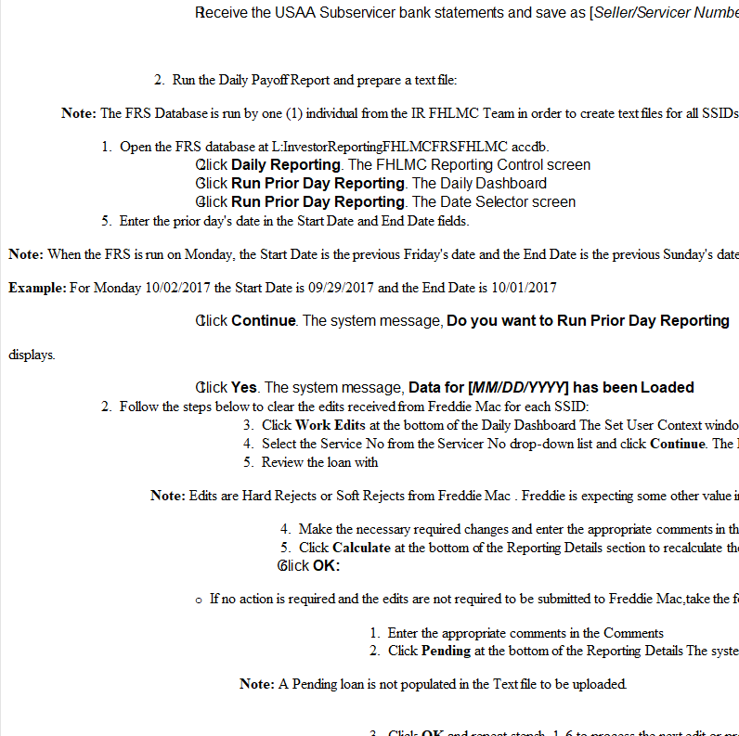
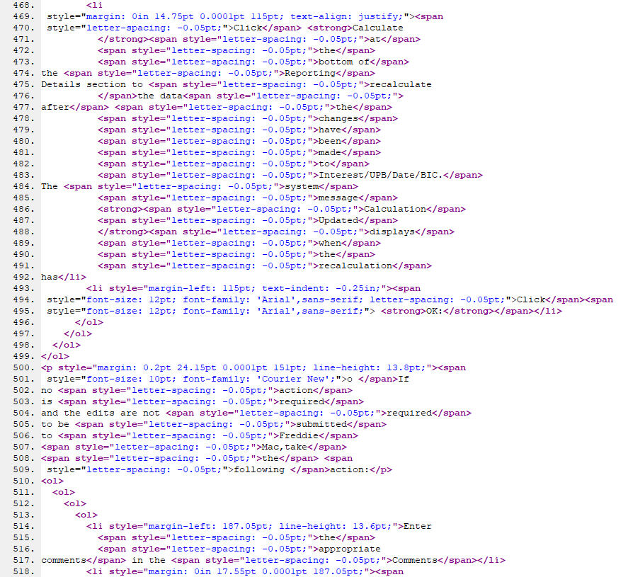
HTML + Archer

Slide 12
The Finished Product:

Slide 13
Process Maps

Slide 14
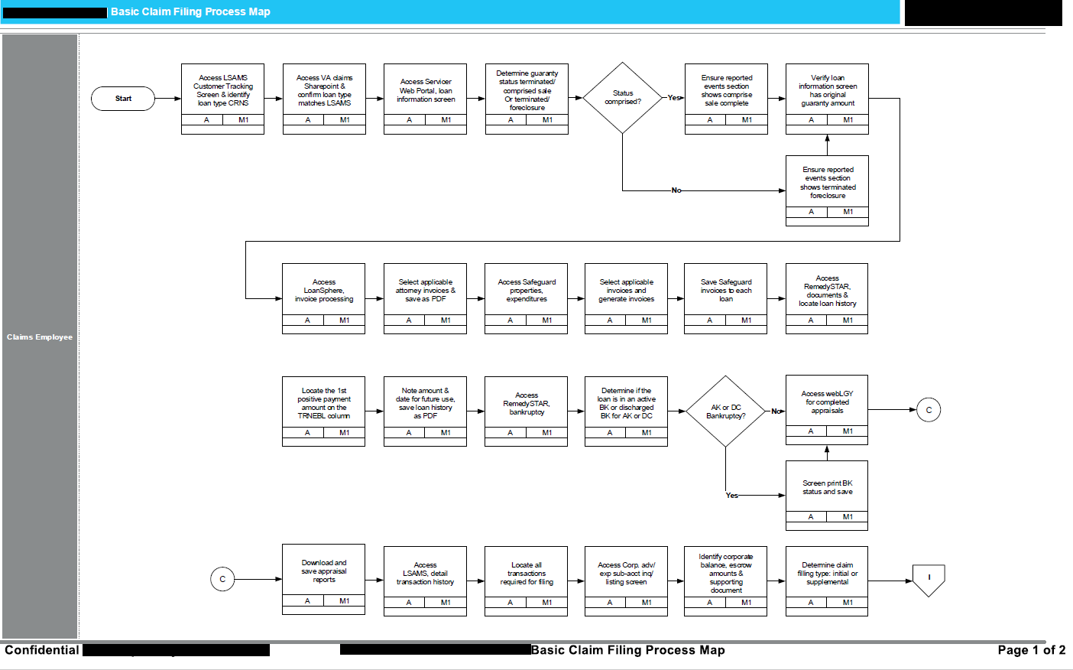
Process Maps
Essential to our Framework project
Help track process and identify break points
Identify processes that can be automated
Provide a holistic view of a process

Slide 15
Process Maps cont.
To date I have:
Transferred 51 process maps into VISIO
Helped with the Mediations Framework map
Created Tier one maps
Transferred ‘White Board’ maps into VISIO
Quality Checked 30 maps before Archer upload

Slide 16
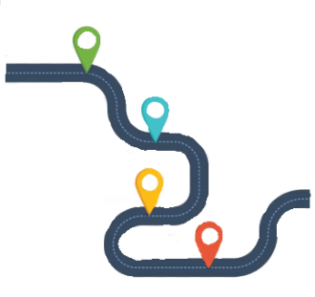
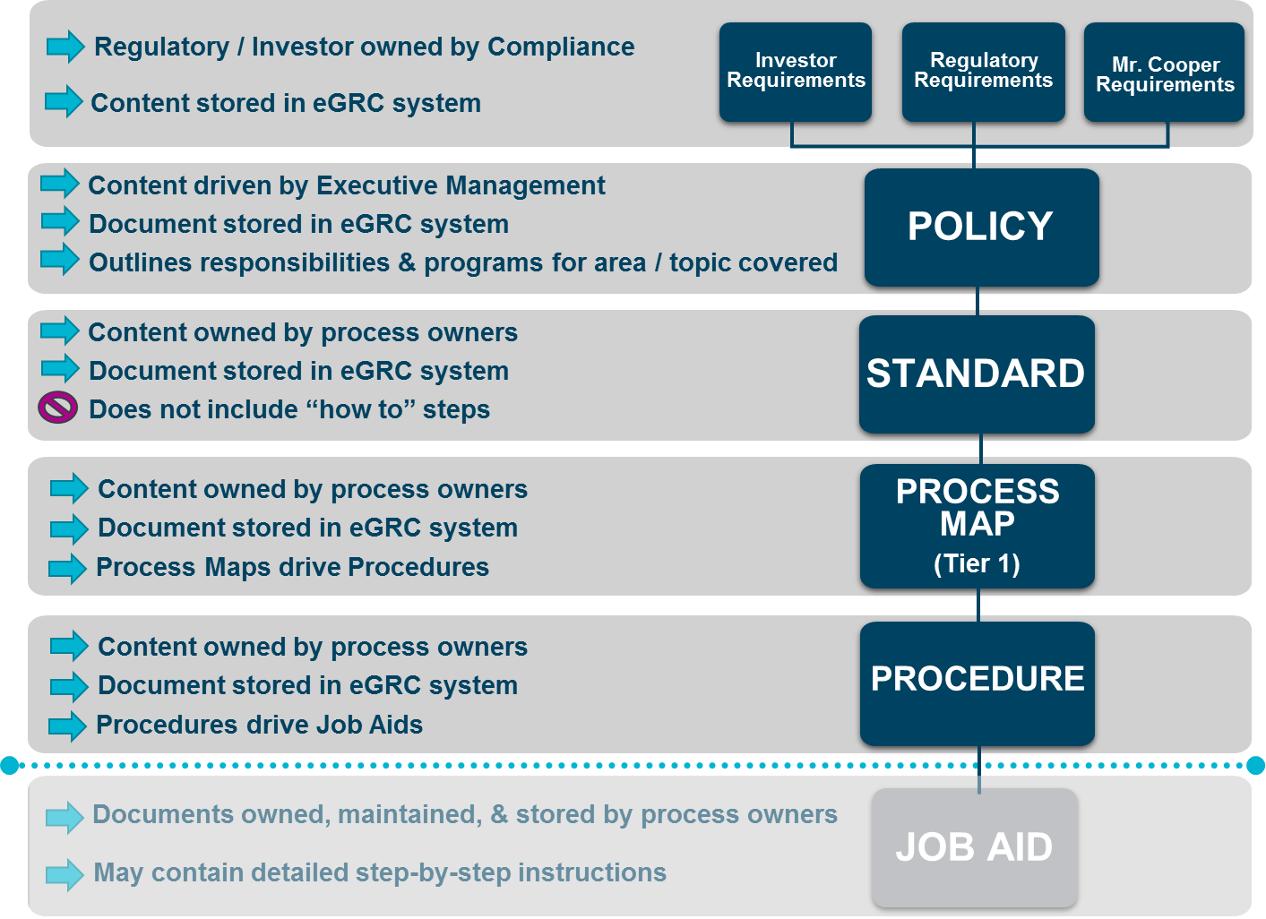

Change Governance Office Framework

Slide 17
Final Thoughts

Slide 18
How Do I Leave a Mark?
How I left a mark:
Completed 24 Urgent Documents
I interacted most with our Research and Resolution Department 17 documents)

